Slide 1
Joins Part 2 and Using Aliases

Slide 2
Aliases using AS (saves some typing)
Syntax:
Mainly, I just wanted to make sure you did not get confused if you see someone write SQL using aliases for Table.column
Select lastname, firstname, jobtitle, CompanyName
from Employee as E
Join Customer as C
on E.EmpNo = C.AcctRepNo
order by Lastname, CompanyName

Slide 3
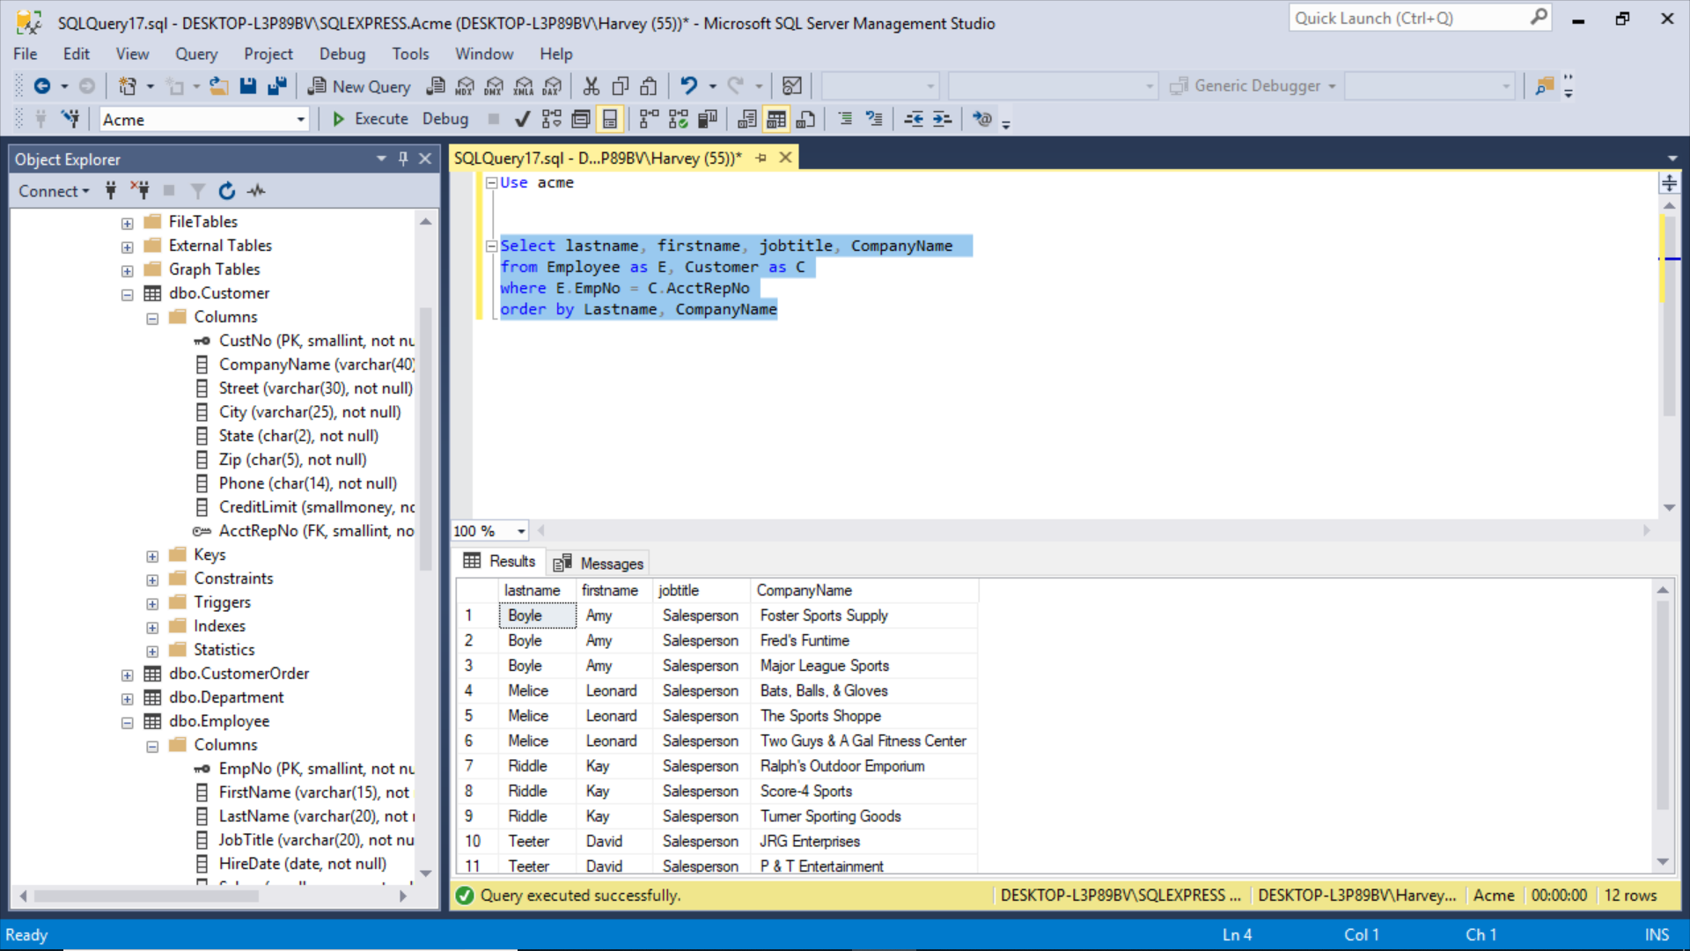
It worked!

Slide 4
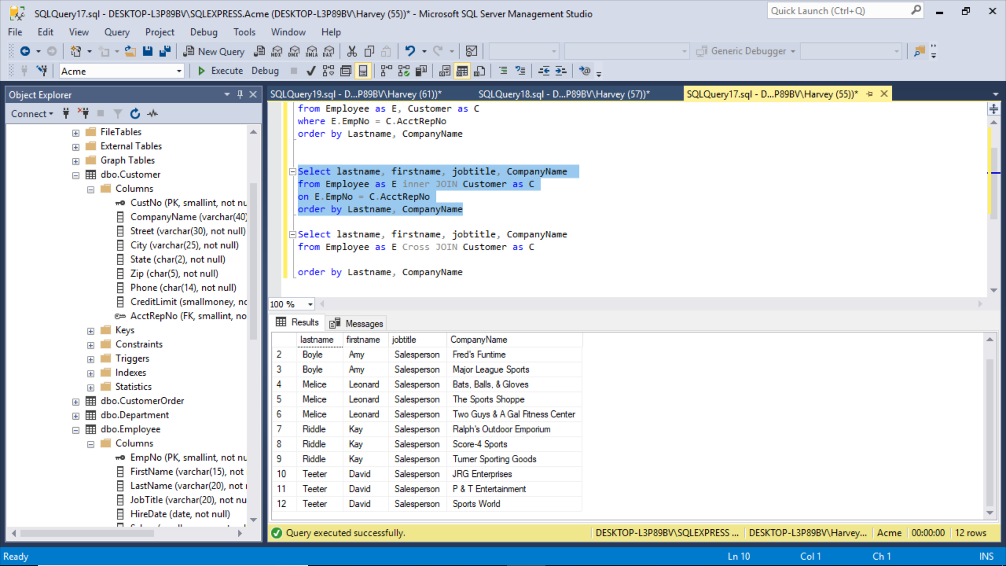
Using “Inner JOIN” and “ON”

Slide 5
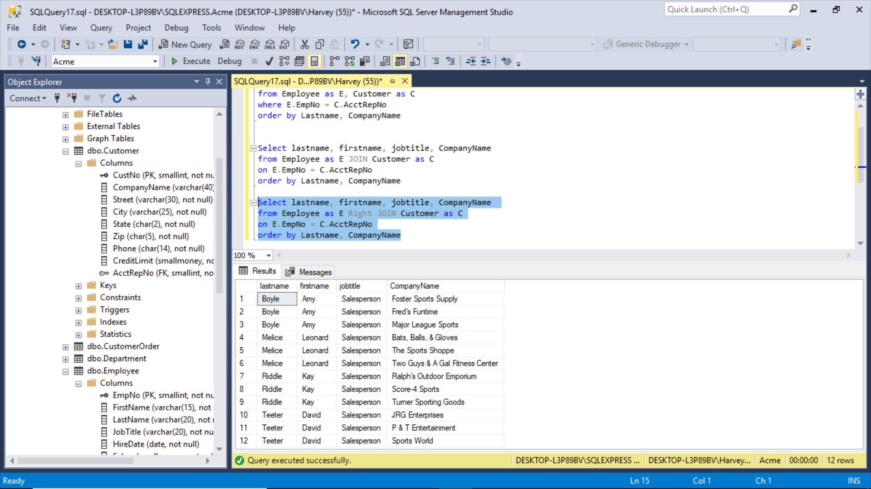
By the way, JOIN with no modifier is treated as INNER
Right Join (notice I can leave out “outer”)

Slide 6
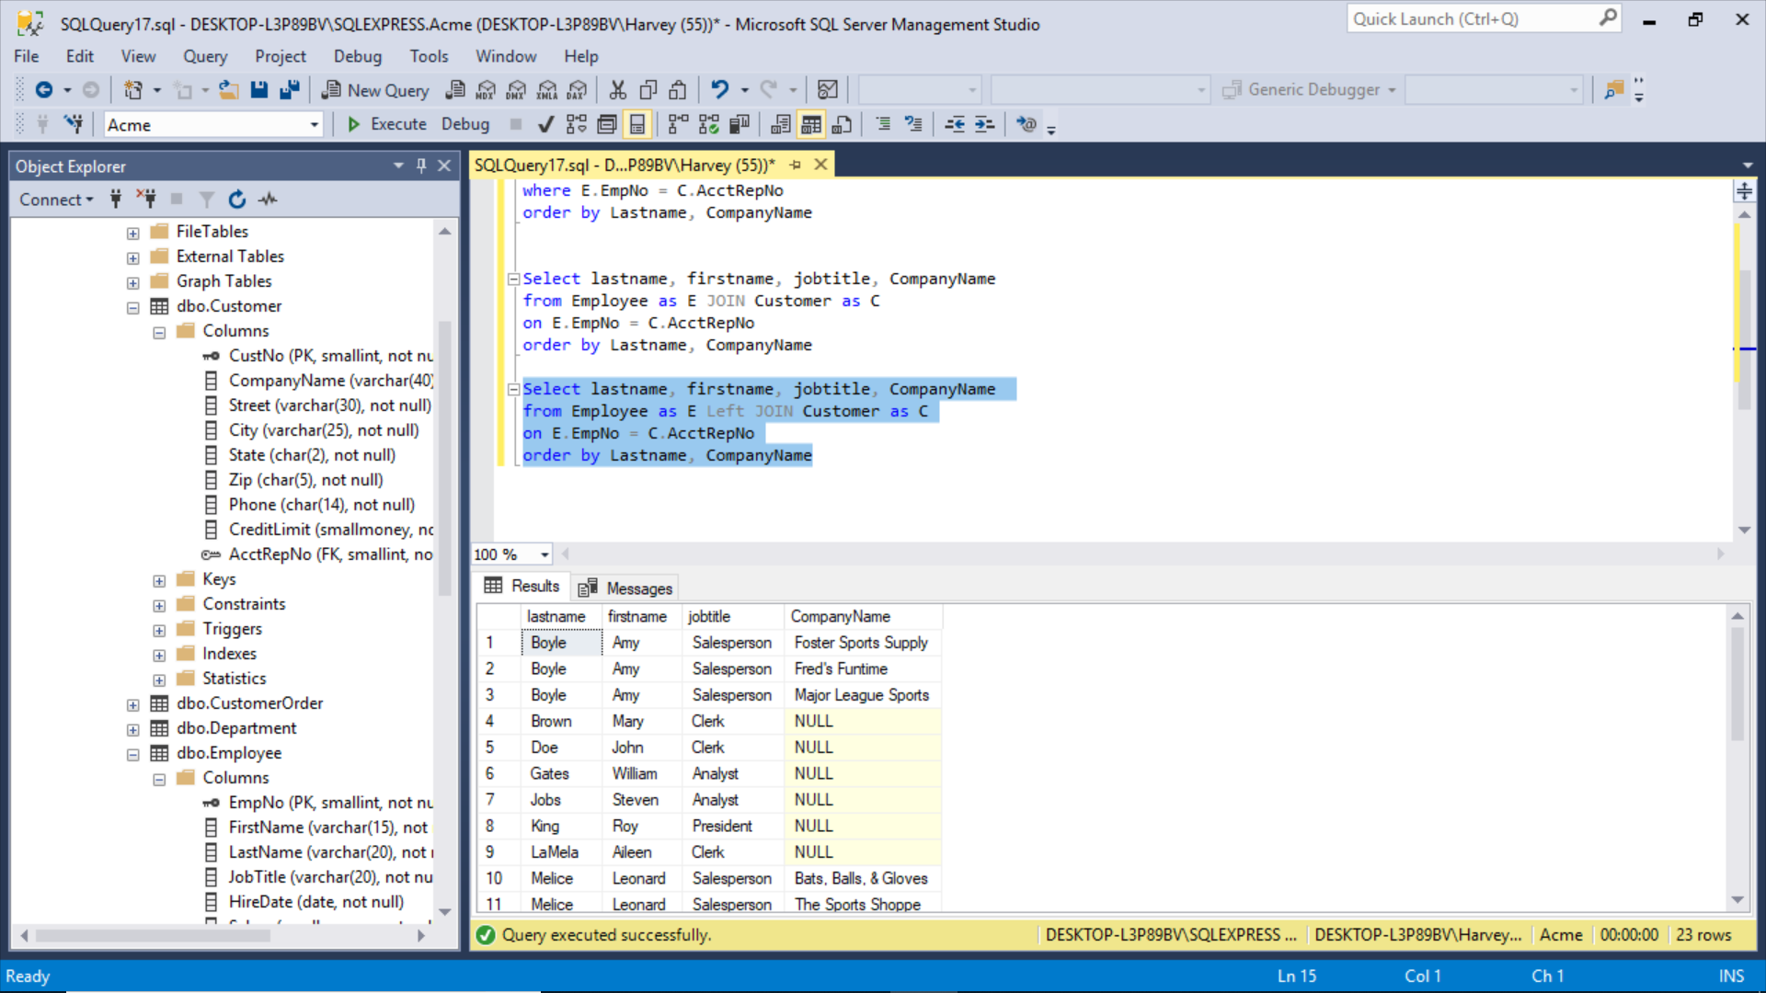
Left Join

Slide 7
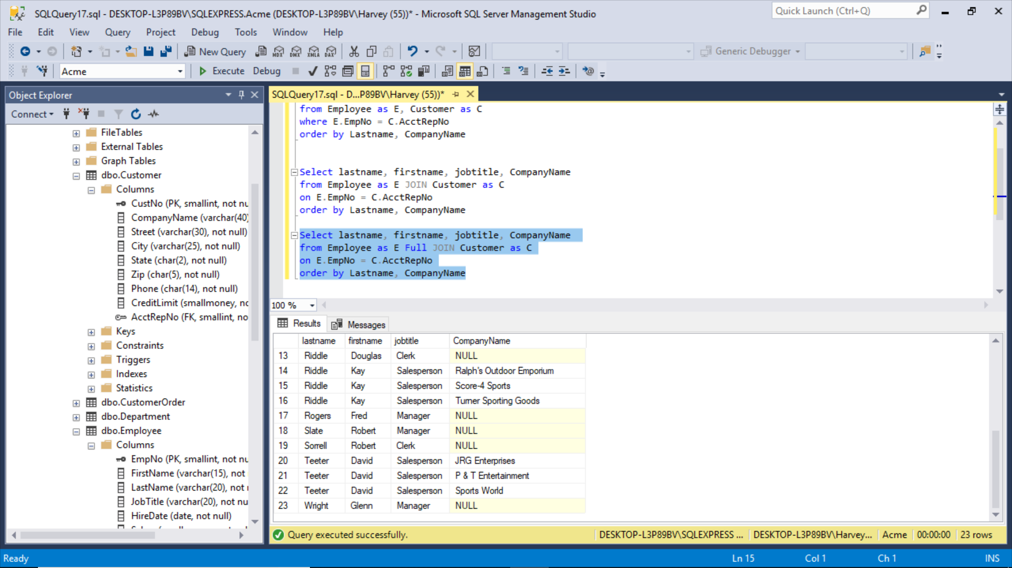
Full Join

Slide 8
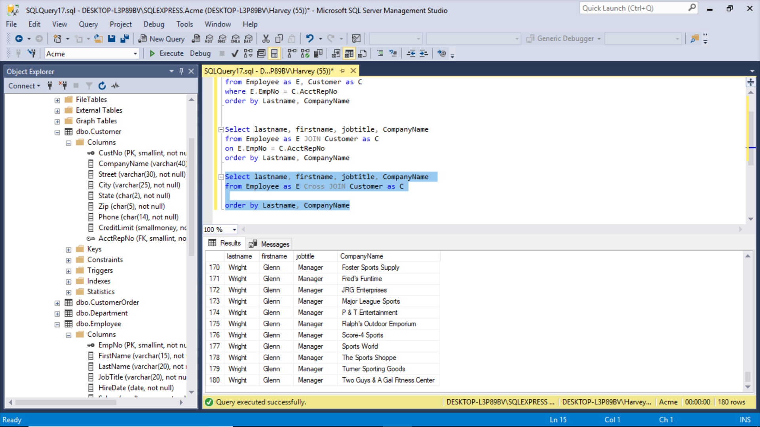
Cross Join

Slide 9
SQLCMD “our old friend”
Use Acme
select actualPrice
from OrderLine
Select MinPrice
from Price
select OrderLine.ActualPrice, Price.MinPrice
from OrderLine, Price
where ActualPrice = MinPrice
select OrderLine.ActualPrice, Price.MinPrice
from OrderLine
Left Join Price
On OrderLine.ActualPrice = Price.MinPrice
Order by MinPrice
select OrderLine.ActualPrice, Price.MinPrice
from OrderLine
Right Join Price
On OrderLine.ActualPrice = Price.MinPrice
Order by MinPrice

Slide 10
select Customer.companyname, Customerorder.orderdate
from customer, CustomerOrder
where orderdate > '2011-08-31'
Select CompanyName, orderdate
from Customer
Right Join CustomerOrder
On CustomerOrder.OrderDate > '2011-08-31'

Slide 11
Hospital Database

Slide 12
SQLCMD is faster than SSMS if your DD is organized:
Create database hotel
Go
Use hotel
go
Create table clerk
(clerkID int primary key not null,
firstName varchar(10) not null,
lastName varchar(10) not null,
Street varchar(10) not null,
City varchar(10) not null,
State char(2) not null,
Zip varchar(5) not null,
Phone varchar(14) not null);
Go
Drop database hotel
Go
I keep several “standard table create scripts” ready to go.

Slide 13
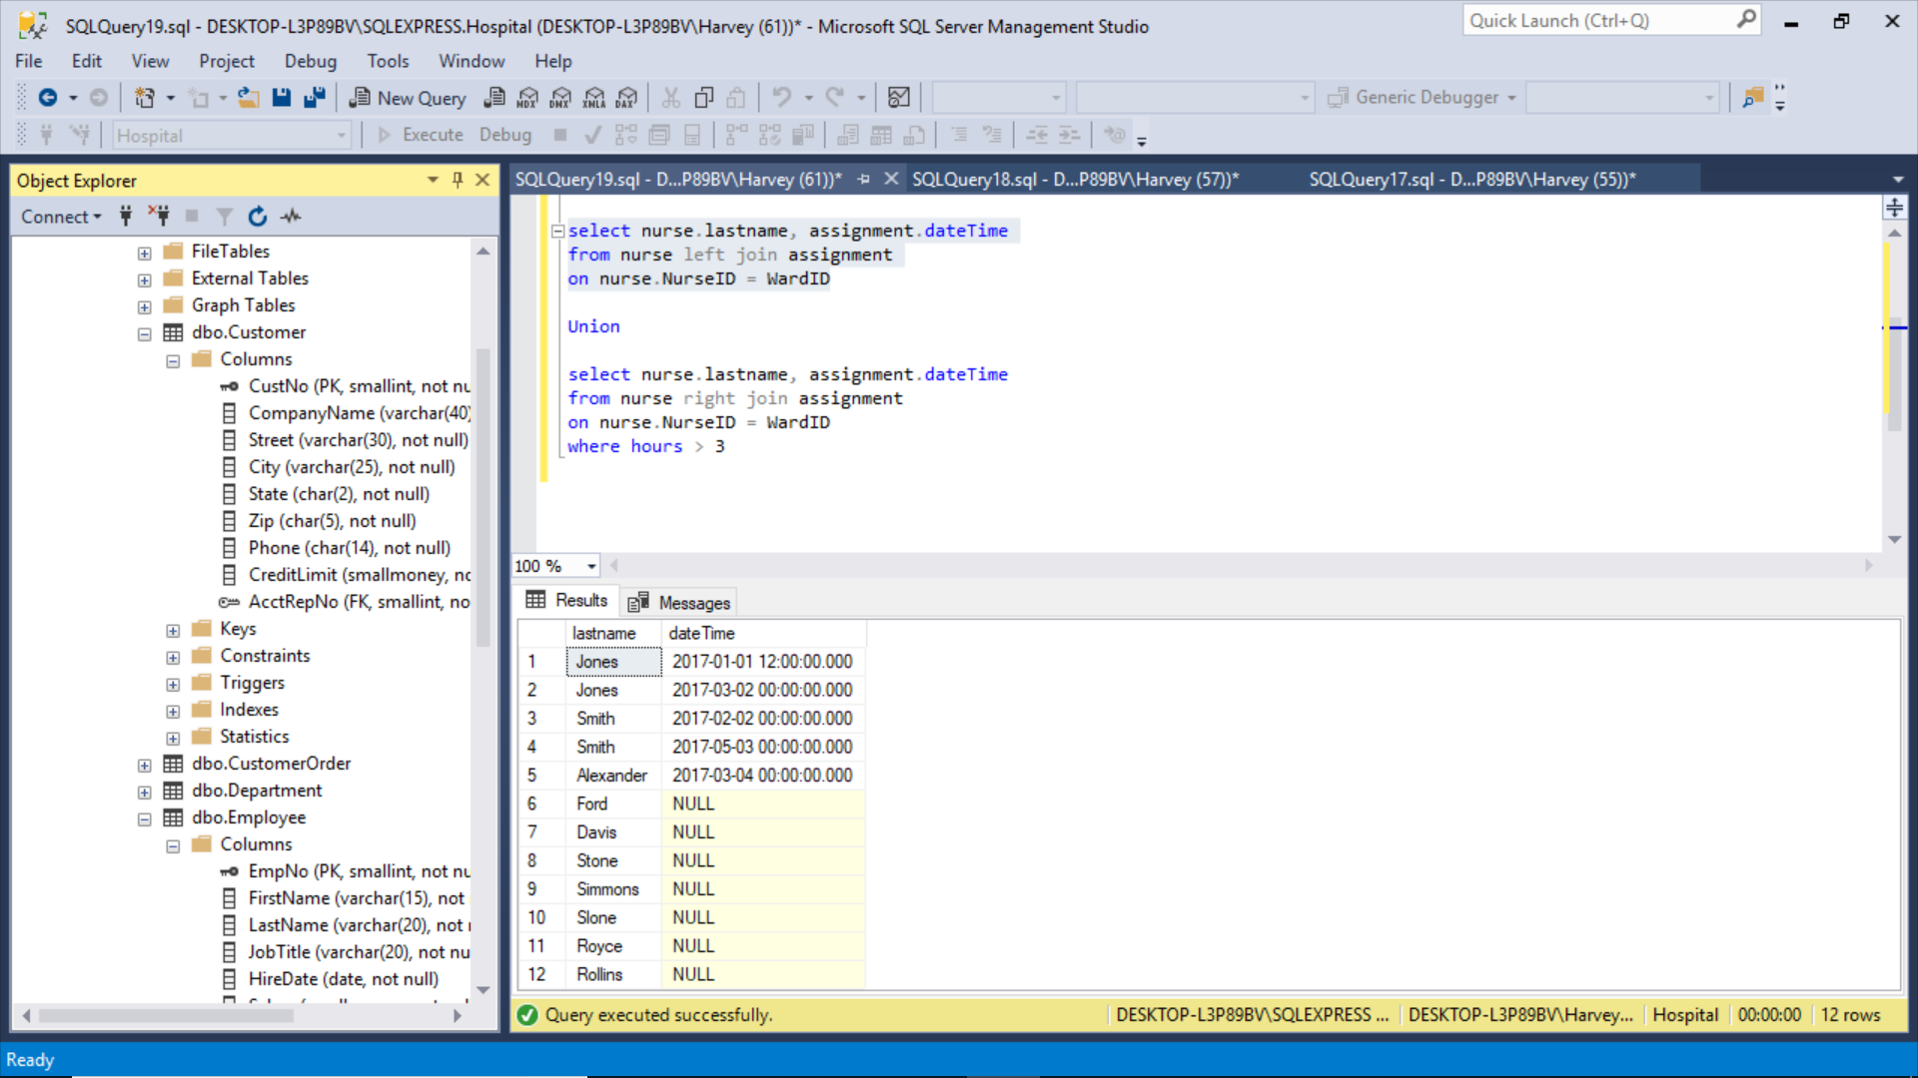
Left Join

Slide 14
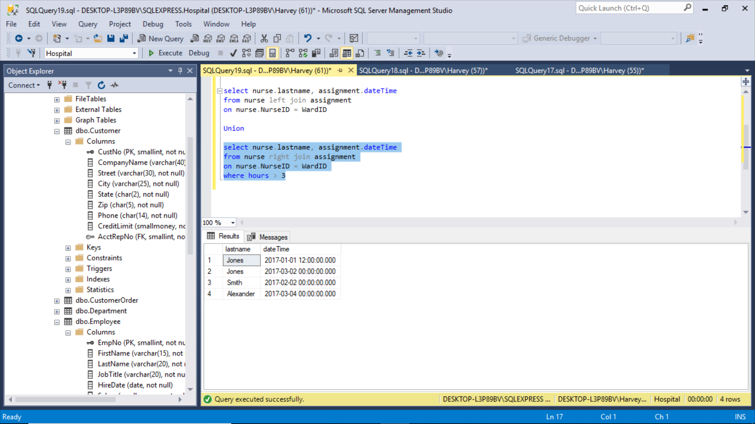
Right Join

Slide 15
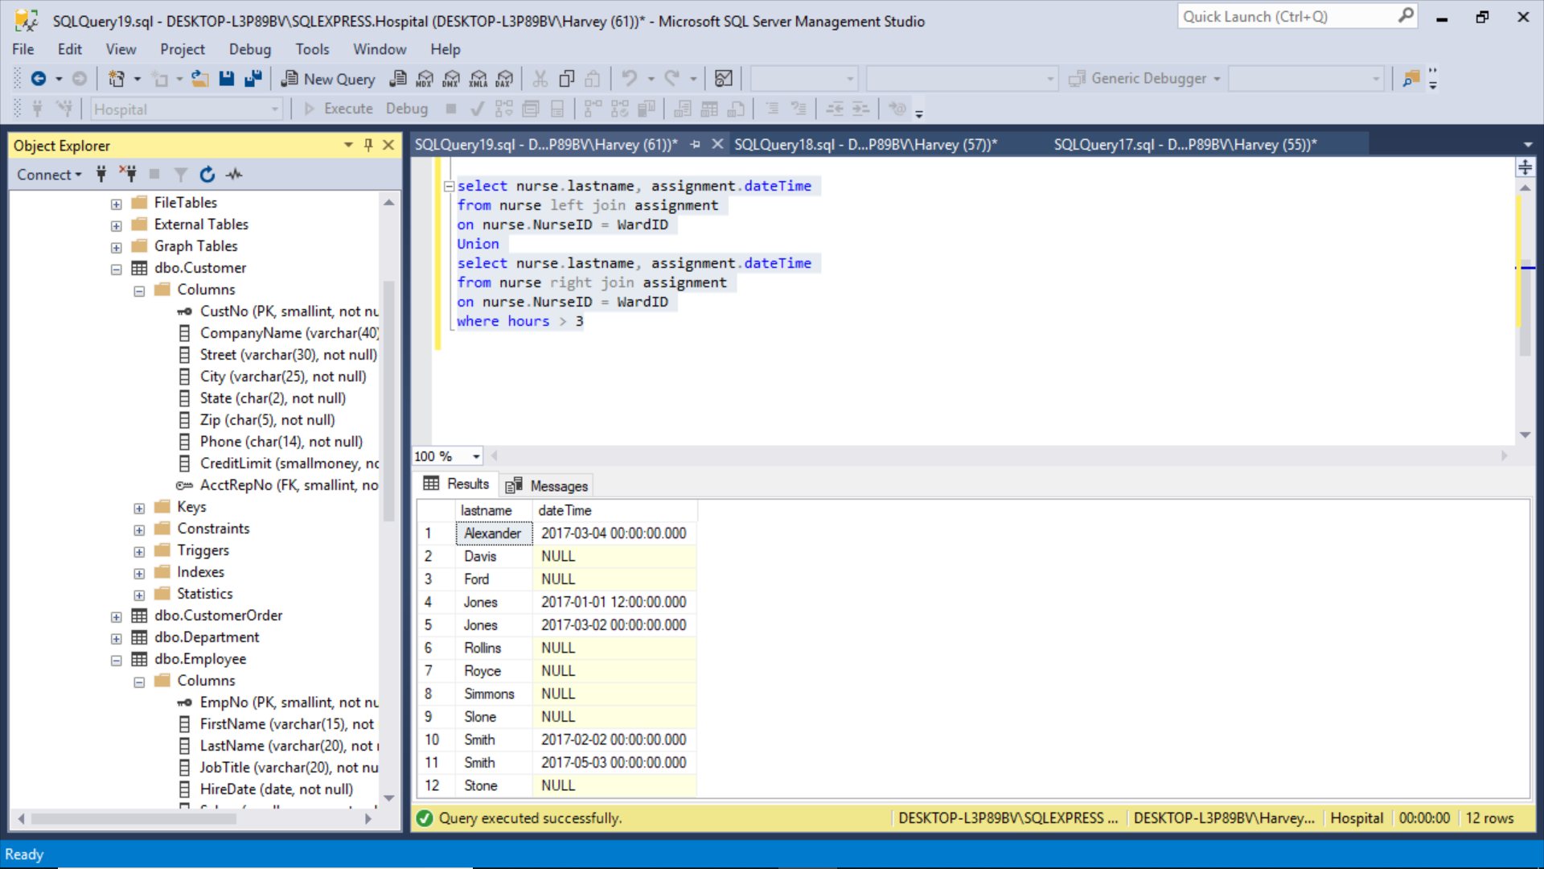
Union

Slide 16
SQLCMD “our old friend”
use Hospital
select nurse.LastName, Assignment.startdateTime
from nurse, Assignment
where hours > 3
select nurse.lastname, assignment.startdateTime, bed.bedsize
from nurse
join assignment
on nurse.NurseID = WardID
join Ward
On nurse.chargenurseID = nurse.nurseid
Join bed
On bed.wardid = ward.wardid
select nurse.lastname, assignment.startdateTime
from nurse
left join assignment
on nurse.NurseID = assignment.nurseID
select nurse.lastname, assignment.startdateTime
from nurse
left join assignment
on nurse.NurseID = assignment.WardID
where hours > 3
select nurse.lastname as 'Nurse', patient.lastname as 'Patient', bed.bedsize
from nurse
join Ward
On ward.chargenurseID = nurse.nurseid
Join bed
On bed.wardid = ward.wardid
Right join patient
on bed.bedid = patient.BedID
order by patient.lastname

